Slide 1

第12課 病気 Lesson 12 Feeling ill Grammar
Dr. Jiajun Bracewell

Slide 2
Objectives
1 ～んです
2 ～すぎる
3 ～ほうがいいです
4 ～ので
5 ～なければなりません／なきゃいけません
6 ～でしょう
表現ノート Expression Notes

Slide 3
1 ～んです
There are two distinct ways to make a statement in Japanese.
One way is to simply report the facts as they are observed. This is the mode of speech that we have learned so far.
In this lesson, we will learn a new way: the mode of explaining things.

Slide 4

1 ～んです
バスが来ませんでした .
A report is an isolated description of a fact.
When you are late for an appointment, you can already report in Japanese what has happened
This sentence, however, does not have the right apologetic tone, because it is not offered as an explanation for anything.
バスが来なかったんです。 (As it happens,) the bus didn't come.
If you want to mention the busses failing to run on time as an excuse for being late, you will need to use the explanation mode of speech,
have the right apologetic tone

Slide 5
1 ～んです
An explanation has two components,
one that is explicitly described in the sentence (the bus not coming),
and another, which is implied, or explained, by it (you being late for the appointment).
The sentence-final expression んです serves as the link between what the sentence says and what it accounts for.

Slide 6
1 ～んです
あしたテストがあります。 I have an exam tomorrow. (a simple observation)
あしたテストがあるんです。 I have an exam tomorrow. (So I can't go out tonight.)
トイレに行きたいです。 I want to go to the bathroom. (declaration of one's wish)
トイレに行きたいんです。 I want to go to the bathroom. (So tell me where it is.)

Slide 7
1 ～んです
んです goes after the short form of a predicate.
The predicate can be either in the affirmative or in the negative, either in the present tense or in the past tense.
んです itself is invariant and does not usually appear in the negative or the past tense forms.
成績がよくないんです。
(in response to the question, "Why do you look so upset?")
(As a matter of fact) My grade is not good.
試験が終わったんです。
(explaining to a person who has caught you smiling)
The exam is over. (That's why I 'm smiling.)

Slide 8
1 ～んです
In writing, のです.
成績がよくないのです。
In casual exchanges, んだ .
成績がよくないんだ。
In casual questions, の . We will examine these further in Lesson 15.
成績がよくないんですか。
成績がよくないの？

Slide 9
1 ～んです summary
 | In Colloquial | In writing
explanation | ～んです | ～のです
exchanges | ～んだ | ～のだ
question | ～んですか？ | ～のですか？
casual question | ～の？

Slide 10
1 ～んです
When it follows a noun or a な -adjective,な comes in between.
 | report sentences | explanation sentences
な-adjective: | 静かです | 静かなんです
noun: | 学生です | 学生なんです

Slide 11
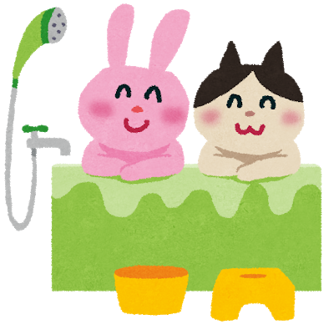
1 ～んです
You can use んです in questions to invite explications and further clarifications from the person you are talking to.
It is very often used together with question words, such as どうして (why) and どうした (what has happened).
Ｑ：どうして彼と別れたんですか。Why did you break up with your boyfriend? (You've got to tell me.)
Ａ：彼、ぜんぜんお風呂に入らないんです。Oh, him. He never takes a bath. (That's a good enough reason, isn't it?)

Slide 12
1 ～んです
Ｑ：どうしたんですか。What happened? (You look shattered.)
Ａ：猫が死んだんです。My cat died. (That should explain how I look today.)
A どうしたんですか question is best answered by a んです sentence with the subject marked with the particle が rather than は , as in this example.
See Lesson 8 for a related discussion.

Slide 13
1 ～んです
You can also use んです to provide an additional comment on what has just been said.
Ａ：とてもいい教科書ですね。That's a great textbook that you are using.
Ｂ：ええ。私の大学の先生が書いたんです。You bet. The professors at my university wrote it (for your information).
In the written language, you see のです instead of んです . It has the same functions but is stylistically more formal.

Slide 14
2 ～すぎる
Verb stems +すぎる
Verb stems may be followed by the helping verb すぎる , which means "too much," or "to excess."
~すぎる conjugates as a regular ru-verb.
早く起きすぎました。 I got up too early.
食べすぎてはいけません。 You must not eat too much.

Slide 15
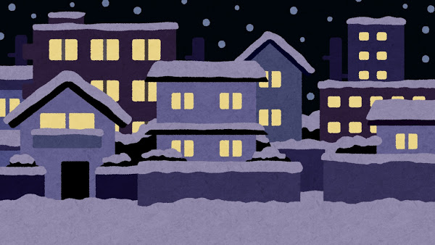
2 ～すぎる
い - and な -adjective bases +すぎる
い - and な -adjective bases (the parts which do not change in conjugations);
you drop the い and な at the end of the adjectives and then add すぎる .
高い
この本は高すぎます。 To This book is too expensive.
静かな
この町は静かすぎます。 This town is too quiet.

Slide 16
2 ～すぎる
You use すぎる when something is beyond normal or proper, suggesting that you do not welcome it.
親切すぎます (too kind) is not a straightforward compliment.
Use modifiers like とても and すごく if you simply want to say that something is in a high degree.
とても親切です。
すごく親切です。

Slide 17
3 ～ほうがいいです
ほうがいいです " it is better (for you) to do ... "
is a sentence-final expression that you can use to give advice.
When you suggest an activity with ほうがいいです , you are giving a very specific piece of advice;
namely, that it is advisable to do it, and if one does not follow the advice, there is a danger or a problem.

Slide 18
3 ～ほうがいいです
ほうがいいです is peculiar in that it follows different tense forms, depending on whether the advice given is in the affirmative or the negative.
When the advice is in the affirmative, ほうがいいです generally follows the past tense short form of a verb.
もっと野菜を食べたほうがいいですよ。 You'd better eat more vegetables.
When the advice is in the negative, however, the verb is in the present tense short form.
授業を休まないほうがいいですよ。 It is better not to skip classes.

Slide 19
4 ～ので
You can use ので to give the reason for the situation described in the balance of the sentence.
Semantically, ので is just like から .
Stylistically, ので sounds slightly more formal than から .
(reason) ので， (situation) 。
(situation), because (reason).

Slide 20
4 ～ので
いつも日本語で話すので、日本語が上手になりました。
My Japanese has improved, because I always speak Japanese.
宿題がたくさんあったので、きのうの夜、寝ませんでした。
I did not sleep last night, because I had a lot of homework.
The reason part of a sentence ends in a short form predicate.

Slide 21
4 ～ので
When ので follows a な -adjective or a noun, な comes in between, as it did with the explanatory predicate んです .
その人はいじわるなので、きらいです。
I do not like that person, because he is mean.
今日は日曜日なので、銀行は休みです。
Banks are closed, because today is a Sunday.

Slide 22
5 ～なければいけません ～なきゃいけません
We use なければいけません and なきゃいけません to say that it is necessary to do something, or "must."
なきゃ variant is very colloquial and is mainly found in the spoken language,
なければ variant is more formal, often seen in the written language.
試験があるから、勉強しなければいけません ／ なきゃいけません。
I have to study a lot, because there will be an exam.

Slide 23
5 ～なければいけません ～なきゃいけません
なければ and なきゃ means "if you do not do . . ."
いけません roughly means "you cannot go";
なければいけません and なきゃいけません therefore literally means "you cannot go not doing ..." with the double negatives giving rise to the affirmative sense of the mandate.

Slide 24
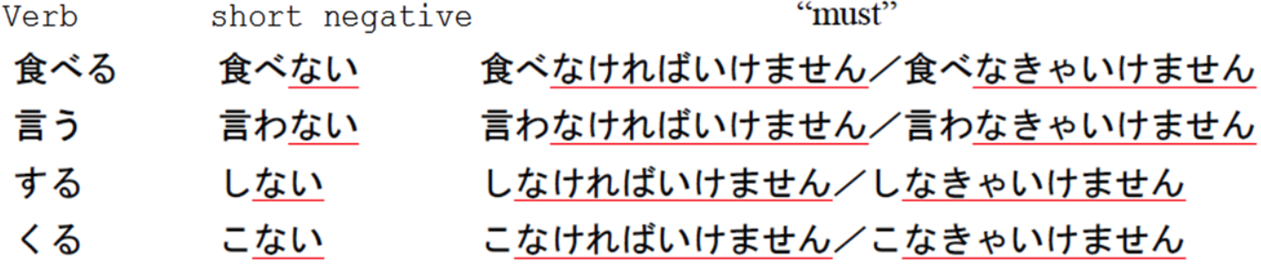
5 ～なければいけません ～なきゃいけません
な in なければ and なきゃ comes from the negative ない. Just drop the last い and replace it with ければ or きゃ.

Slide 25
5 ～なければいけません ～なきゃいけません
You can change いけません
to いけませんでした to say you had to,
to なきゃいけない (the short form, present tense) in casual speech
to なければいけない in the written language.
けさは、六時に起きなきゃいけませんでした。 (long form, past)
I had to get up at six this morning.
毎日、練習しなきゃいけないんです。 (short form. present)
(The truth is,) I must practice every day.

Slide 26
5 ～なければいけません ～なきゃいけません
～なければ | いけません／なりません
～なきゃ | いけません／なりません
～なくては | いけません／なりません
～なくちゃ | いけません／なりません
～ないと | いけません／なりません

Slide 27
5 ～なければいけません ～なきゃいけません
In casual speech, you can also leave out いけません and end the sentence like:
食べなきゃ 。
食べなくちゃ。
食べないと。

Slide 28
6 ～でしょう
We use the sentence-final expression でしょう (probably) when we are making a guess or a prediction.
でしょう follows verbs and い-adjectives in short forms, in the affirmative and in the negative.
でしょう may also follow predicates in the past tense. We will, however, concentrate on the present tense examples in this lesson.

Slide 29

6 ～でしょう
Verb +でしょう
あしたは雨が降るでしょう。 It will probably rain tomorrow.
あしたは雨が降らないでしょう。 It will probably not rain tomorrow.
い –adjective +でしょう
北海道は寒いでしょう。 It is probably cold in Hokkaido.
北海道は寒くないでしょう。 It is probably not cold in Hokkaido.

Slide 30
6 ～でしょう
でしょう may also follow な -adjective bases and nouns.
な –adjective +でしょう
山下先生は魚が好きでしょう。 Professor Yamashita probably likes fish.
山下先生は魚が好きじゃないでしょう。 Professor Yamashita probably doesn't like fish.

Slide 31
6 ～でしょう
noun +でしょう
あの人はオーストラリア人でしょう。 That person is probably an Australian.
あの人はオーストラリア人じゃないでしょう。 That person is probably not an Australian.
Note that でしょう goes directly after these elements; we do not use
× 〜 なでしょう ,
× 〜 のでしょう ,
× 〜 だでしょう .

Slide 32
6 ～でしょう
でしょう sentences can be turned into questions ( 〜 でしょうか ), which can be used to invite another person's opinion or guess.
日本語と韓国語と、どっちのほうが難しいでしょうか。
Which would you say is more difficult, Japanese or Korean?

Slide 33
6 ～でしょう
The short form of でしょう is だろう . You can use it to cautiously phrase a prediction or an analysis.
たけしさんは興味があるだろうと思います。
I think Takeshi would be interested in it.

Slide 34

6 ～でしょう
In casual exchanges, you can use でしょう (with the question intonation, and most often pronounced as somewhat shorter でしょ ) when you want to check if your partner agrees that you have the correct understanding about what you have just said.
ジョン、中国語がわかるでしょ ？ これ、読んで。
John, you understand Chinese, right? Can you read this for me?

Slide 35
Take care; Get well soon
お大事に。

Slide 36
As much as possible
できるだけ

Slide 37
彼女 彼
彼女 girlfriend
彼 boyfriend
彼氏 boyfriend

Slide 38
L2 トイレ L12 お手洗い

Slide 39
のど
歯（は）

Slide 40

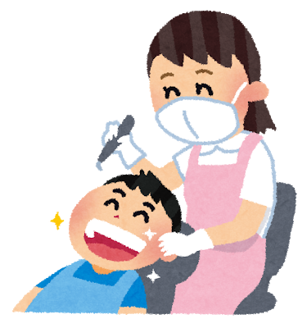
歯（は）tooth
歯科（しか） dentistry

Slide 41
くもり
晴（は）れ

Slide 42
風邪 風邪をひく
せき せきが出る

Slide 43
熱がある
のどがかわく

Slide 44
二日酔（ふつかよ）い

Slide 45
元気がない

Slide 46
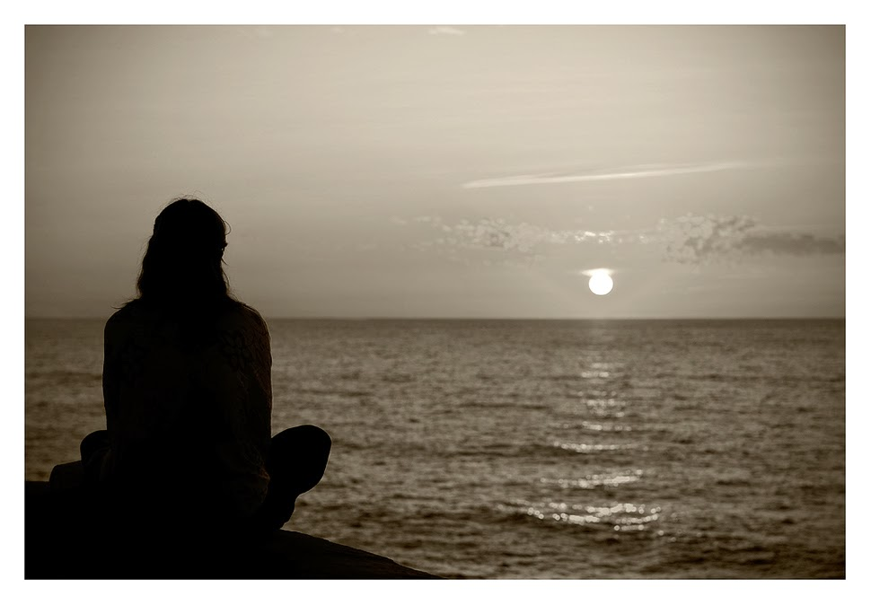
ホームシック
ノスタルジア Nostalgia
This Photo by Unknown Author is licensed under CC BY-SA

Slide 47
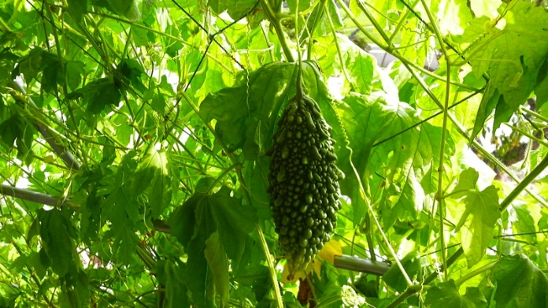
甘い 苦い
甘(あま)い sweet
苦(にが)い bitter
苦瓜 bitter melon
This Photo by Unknown Author is licensed under CC BY-NC-ND

Slide 48
L4 たくさん／L21 少し すこし L12 多い／L17 少ない

Slide 49
L12 狭（せま）い／L15 広（ひろ）い

Slide 50
都合（つごう）が悪い

Slide 51
L3 いい／L12 悪い

Slide 52
すてき（な） nice 、splendid、glorious、resplendent、splendiferous、lovely、not bad、groovy、swell、nifty、slap-up

Slide 53
興味（きょうみ）がある

Slide 54
別れる

Slide 55
Action noun + する
緊張（きんちょう）する
心配（しんぱい）する

Slide 56
二三日
For two to three days.
二三日（にさんにち）
For twenty three days.
二十三日（にじゅうさんにち）

Slide 57
初（はじ）めて
For the first time
初めて
How do you do? (It's) nice to meet you.
初めまして

Slide 58
もうすぐ
Very soon; in a few moments/days

Slide 59

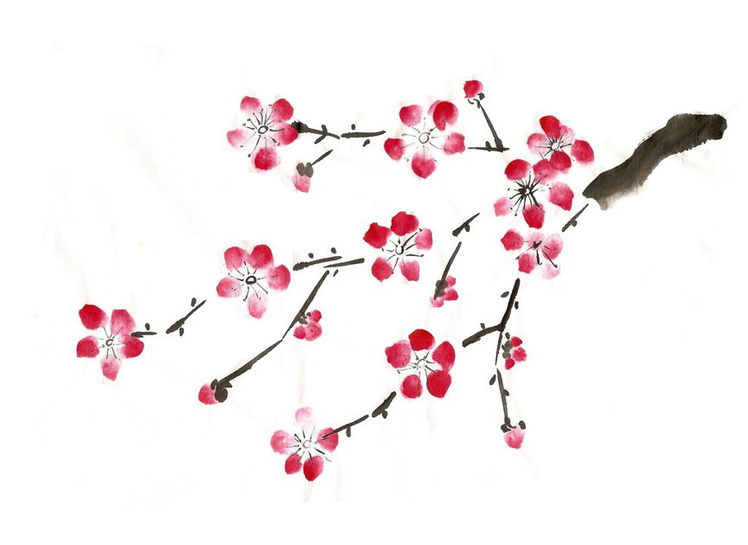
ありがとうございます。

